Slide 1

Medical
Marijuana In The Workplace

Slide 2
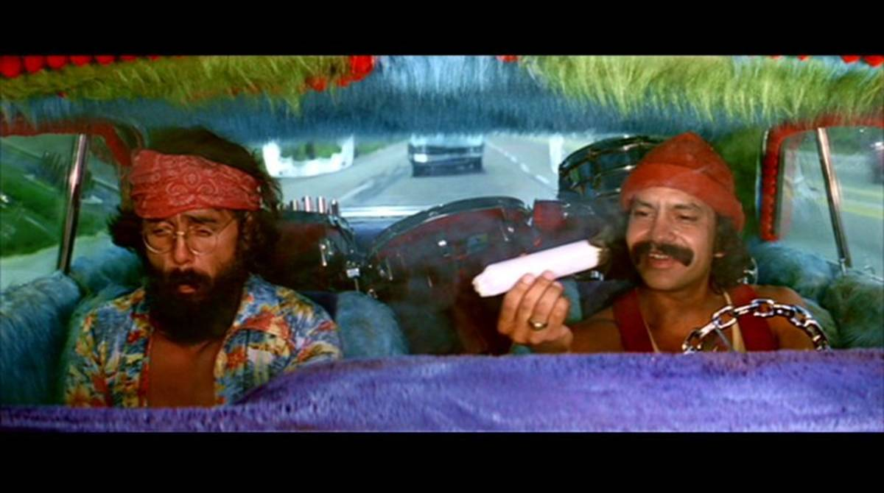
Know these Guys……….?

Slide 3
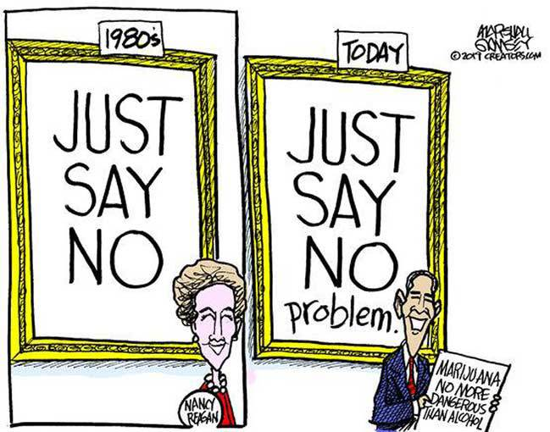

Slide 4
Fun/Interesting Marijuana Facts
In 1972, the first transaction on ARPNET (the precursor to the internet we know today) concerned a marijuana deal between students at Stanford and MIT – The Smithsonian Magazine
Marijuana is today still a Schedule 1 substance under Federal Law; whereas, morphine and oxycodone are Schedule 2
In 2015, 574,641 arrests for possession of marijuana. In 2015, 505,681 arrests made for all other violent crimes including murder, rape and serious assaults – The New York Times
Legalizing pot would generate $8.7 billion in tax revenue annually – CATO Institute

Slide 5
TODAY
162,000 Medical Marijuana Cardholders Statewide
2022 Medical Marijuana monthly sales are averaging $9 million up from $7.2 million in 2021

Slide 6
Medical Marijuana is Legal in Ohio
to treat 26 Different Medical Conditions, including:

Slide 7
Chronic Pain
PTSD
Spinal Cord Disease or Injury
Fibromyalgia
*among other conditions*

Slide 8
Only Prohibited Delivery Form
Is Smoking

Slide 9
W. COMP REBUTTABLE PRESUMPTION DEFENSE
REQUIREMENTS
Notice of Intent
W/I 32 hours for drugs
“Qualifying” Test Facility
Reasonable Cause/Suspicion-Documented

Slide 10
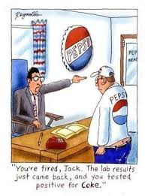
Drug Testing

Slide 11

Case Study
Been with company few years
Has a medical marijuana card
Tardy, glassy eyed, mistake prone
ACCIDENT:
In warehouse when a large plate of steel
he was moving landed on legs.
Rushed to LakeWest ED for treatment
Told co-worker couldn’t pass drug test
Accident report completed
Drug Test:
Cannot pee—not administered day of
injury; 6 days later—Positive
Off work
Termed – Drug Policy Violation

Slide 12
Workers’ Comp Claim
Employee:
Injured on job
Medical Marijuana Card
Crush injury caused by accident
Employer:
Rebuttable Presumption Defense?
(b) The employee, through a qualifying chemical test administered
within thirty-two hours of an injury, is determined to have one of the
following controlled substances not prescribed by the employee’s
physician in the employee’s system that tests above the following
levels:
(ii) For cannabinoids, fifty nanograms per milliliter of urine

Slide 13
Disability Benefits
Employee:
Medco-14 – disabled by crush injury
Employer:
Fired. No TTD?
RE 4123.56
(F) If an employee is unable to work or suffers a wage loss as the direct result of an impairment arising from an injury or occupational disease, the employee is entitled to receive compensation under this section, provided the employee is otherwise qualified. If an employee is not working or has suffered a wage loss as the direct result of reasons unrelated to the allowed injury or occupational disease, the employee is not eligible to receive compensation under this section. It is the intent of the general assembly to supersede any previous judicial decision that applied the doctrine of voluntary abandonment to a claim brought under this section. R.C. §4123.56

Slide 14
Loses Job
Employee:
ADA Discrimination
Ohio
Employer:
Zero Tolerance
Illegal Controlled Substance under Federal Law
Drug Use not Disability

Slide 15
RECAP
Drug-Free Workplace Programs
Still Control
NO FMLA/ADA ACCOMODATION
Employer CAN FIRE for Medical
Marijuana Use

Slide 16
“JUST CAUSE” If DFWP or Zero Tolerance Policy
NO CHANGE as to the Rebuttable Presumption Defense

Slide 17
YOUR QUESTIONS

Slide 18
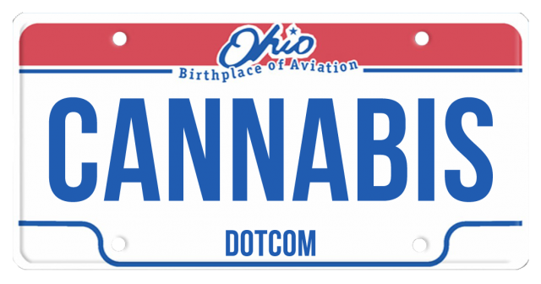
THE END

